Slide 1
ML-Driven Bank Churn Prediction: Unlocking Customer Retention Insights, Analyzing Demographic and Financial Factors
By
Aditya Mane
Data Scientist (Intern)
Date : 04/10/2025

Slide 2
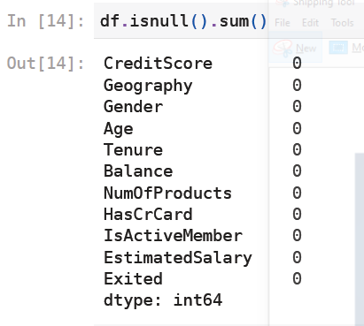

Data Cleaning
Check for Null Values:
Check for Duplicated Values:
Conclusion:
Dataset Doesn't have any null and duplicated values.

Slide 3
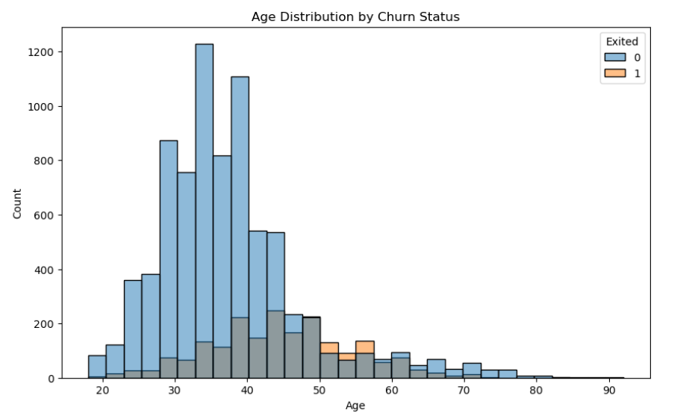
EDA (Exploratory Data Analysis)
Distribution of Age by Churn Status:
Younger individuals (20-50) tend to stay, especially those in their 30s.
There is an increase in churn rates among middle-aged individuals (40-50), highlighting a potential area for targeted customer retention strategies.
Distribution of Credit Score by Churn Status:
Median and IQR of credit scores are similar for stayed (0) and churned (1) customers (600–700).
Credit score shows limited distinction between churn and retention. One outlier (~400) in churned group hints at potential low-score churn risk.
Suggests focusing retention on other factors (e.g., Age, Balance) rather than credit score alone.

Slide 4
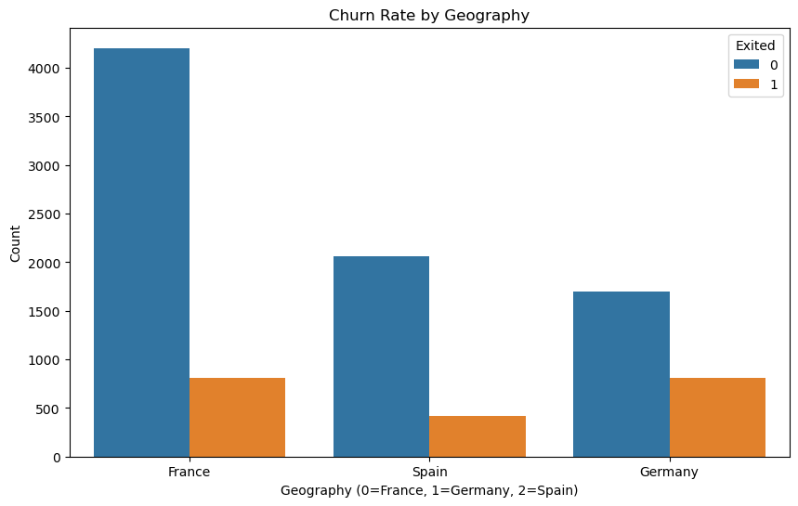
Churn Status by Geography:
France: The highest number of customers (approx. 4,000 stayed, 1,000 churned), indicating the largest customer base with a moderate churn rate.
Spain: Approximately 2,000 stayed and 500 churned, showing a balanced but smaller population with a lower churn rate compared to France.
Germany: Around 1,500 stayed and 1,000 churned, reflecting a higher churn rate relative to the customer base, suggesting Germany as a region with increased churn risk.
Distribution of Account Balance by Churn Status:
Median and IQR (100,000–150,000) for stayed (0) and churned (1) customers, with the churned group having a higher upper range (~250,000), indicating some high-balance customers are at risk.
Lower ranges are consistent near 0. This supports targeting high-balance customers for retention.

Slide 5
Churn Status by Gender:
Female: Approximately 3,500 stayed and 1,000 churned, indicating a moderate churn rate (approx. 22%).
Male: Around 4,000 stayed and 1,000 churned, showing a slightly lower churn rate (approx. 20%) despite a larger customer base.
Churn Status by Number of Products:
1 Product: Approximately 3,500 stayed and 1,500 churned, indicating a significant churn rate (approx. 30%).
2 Products: Around 4,000 stayed and 500 churned, showing the lowest churn rate (approx. 11%) among the groups.
3 Products: About 200 stayed and 500 churned, reflecting a high churn rate (approx. 71%).
4 Products: Nearly 0 stayed and 100 churned, indicating an extremely high churn rate (nearly 100%).

Slide 6
Correlation
CreditScore: Strongly correlated with itself (1), with negligible correlations with Age (-0.004), Balance (0.0063), and EstimatedSalary (-0.0014).
Age: Perfectly correlated with itself (1), with weak positive correlation with Balance (0.028) and negligible correlations with CreditScore (-0.004) and EstimatedSalary (-0.0072).
Balance: Highly correlated with itself (1), with a weak positive correlation with Age (0.028) and minimal correlations with CreditScore (0.0063) and EstimatedSalary (0.013).
EstimatedSalary: Perfectly correlated with itself (1), with negligible correlations with CreditScore (-0.0014), Age (-0.0072), and Balance (0.013).

Slide 7
Churn rate by Tenure:
Customers with shorter (0 years) and longer (10 years) tenures exhibit higher churn rates,
while those with mid-range tenure (around 6 years) are more likely to stay, suggesting targeted retention efforts for new and long-term customers.

Slide 8
Customer Churn Distribution
The charts Show 7,963 customers retained (Exited = 0) and 2,037 customers churned (Exited = 1), representing approximately 79.6% retention and 20.4% churn rates.

Slide 9
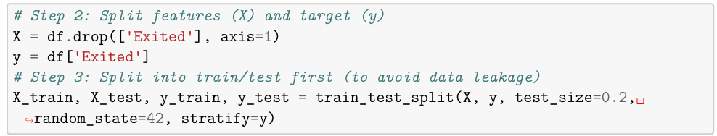
Label Encoding & Data Scaling:
Label Encoding :
This is done for categorical column using LabelEncoder.
Data Scaling:
This is done for the numerical columns using StandardScaler.
Split Data for Training & Testing:

Slide 10
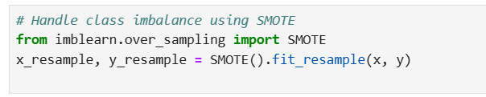
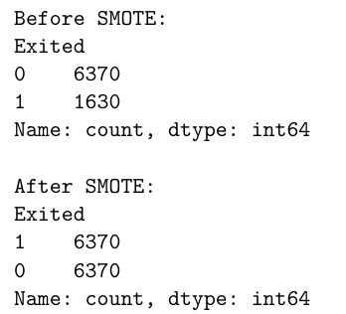
Dealing with Class Churn Data Imbalance:
Used SMOTE (Synthetic Minority Over-sampling Technique)

Slide 11
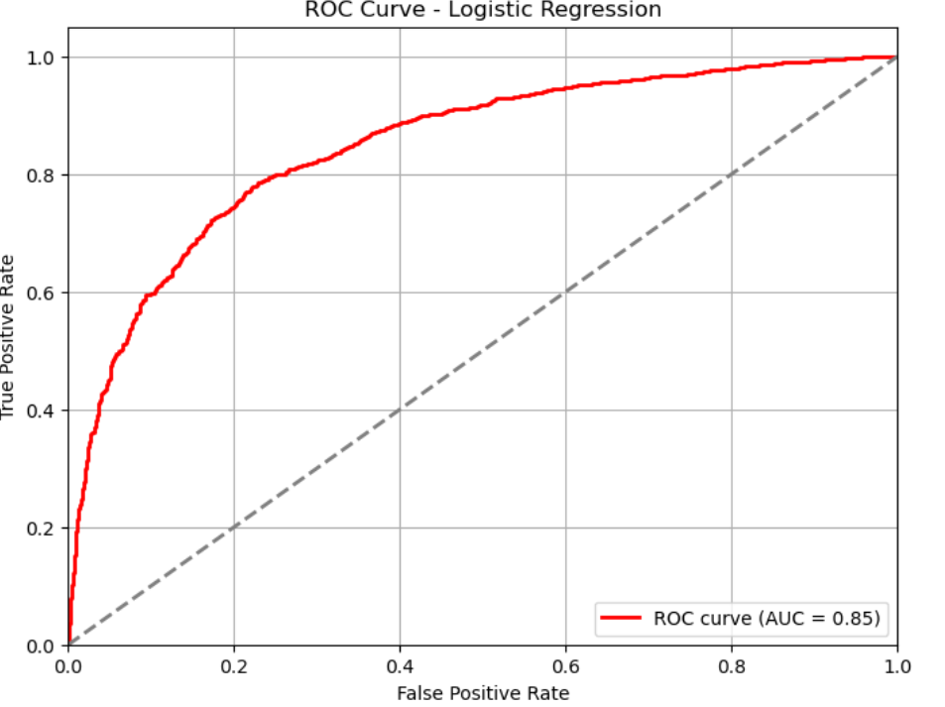
Logistic Regression
Model Building:
Evaluation Matrix for Training Data:
accuracy = 0.7672
precision = 0.7626
recall = 0.7803
f1 score = 0.7713
Confusion Matrix:
[[4773 1557]
[1408 5002]]
Evaluation Matrix for Testing Data:
accuracy = 0.7743
precision = 0.7548
recall = 0.7952
f1 score = 0.7745
Confusion Matrix:
[[1232 401]
[ 318 1235]]

Slide 12
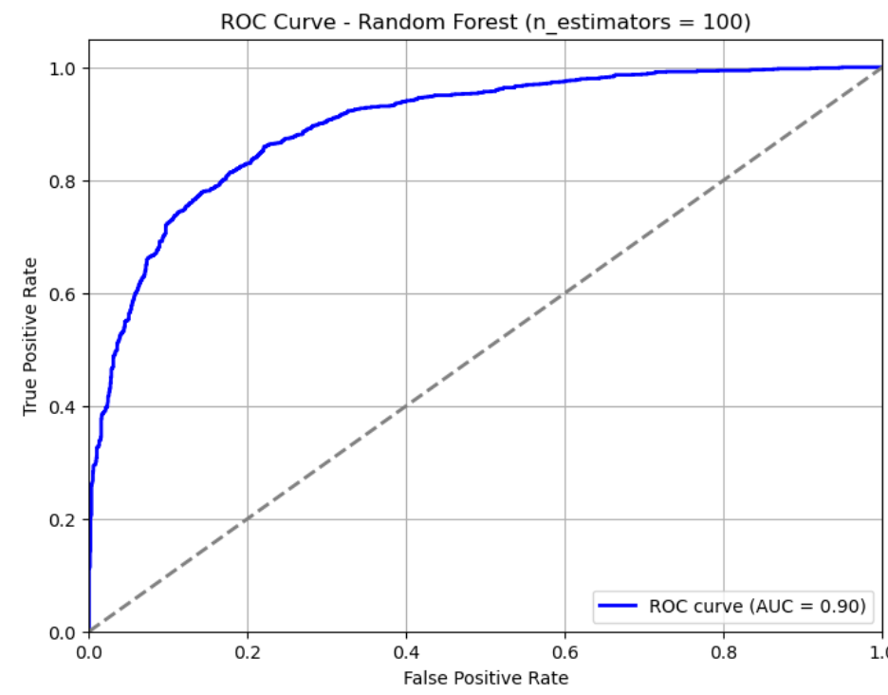
Random Forest
n_estimator = 100
train_accuracy=0.8038,
test_accuracy=0.8148,
Pricision=0.8153,
Recall=0.8016,
F1 score = 0.8084.

Slide 13
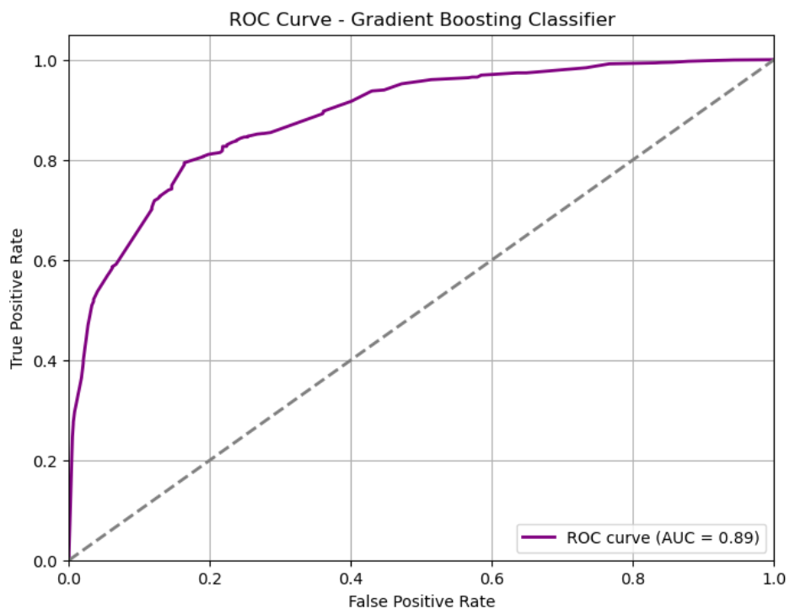
GRADIENT BOOSTING
Evaluation Matrix for Testing Data :
accuracy = 0.8010
precision = 0.7743
recall = 0.8351
f1 score = 0.8035
Confusion Matrix:
[[1255 378]
[256 1297]]
Random Forest is performing better than Gradient Boost

Slide 14
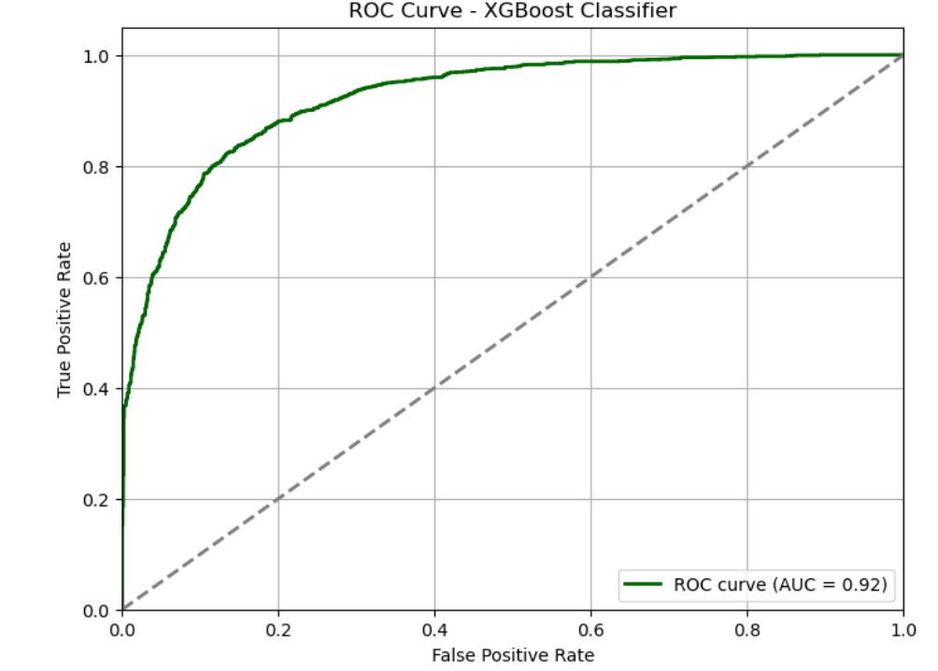
XGBOOST
Evaluation Matrix for Training Data:
accuracy = 0.85
precision = 0.85
recall = 0.84
f1 score = 0.85
Confusion Matrix:
[[5396 934]
[970 5440]]
Evaluation Matrix for Testing Data:
accuracy = 0.84
precision = 0.82
recall = 0.86
f1 score = 0.84
Confusion Matrix:
[[1350 283]
[225 1328]]
XGBOOST Accuracy, precision, recall are coming better than rest of the classification model.

Slide 15
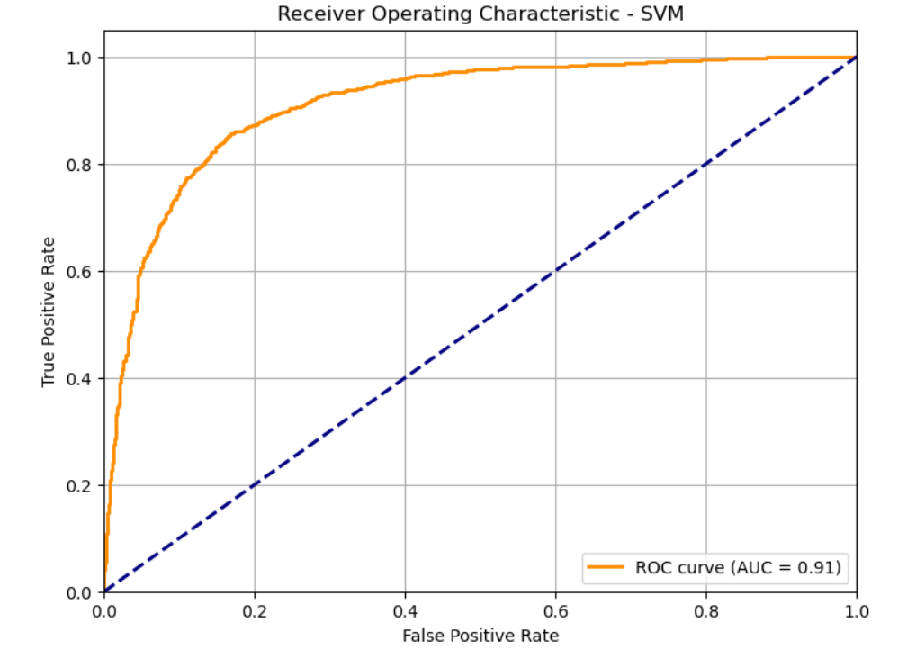
SVM
Evaluation Matrix for Training Data:
accuracy = 0.84
precision = 0.84
recall = 0.83
f1 score = 84
Confusion Matrix:
[[5301 1029]
[1072 5338]]
Evaluation Matrix for Testing Data:
accuracy = 0.84
precision = 0.83
recall = 0.86
f1 score = 0.84
Confusion Matrix:
[[1359 274]
[225 1328]]
SVM - Accuracy, precision, recall are coming better than rest of the classification model but its slightly less than XGBOOST.

Slide 16
THANK YOU!

